Slide 1
Natural language Processing
https://github.com/abhilash499/NLP/tree/master/Spam%20Detection

Slide 2
Objective & approach:
Here we are building an Machine Learning model which can classify News and Advertisement articles.
For making text, machine understandable, used two techniques known as Bag of Words and TF-IDF.
Used different classifier algorithms, testing each of their efficiency.
Programming language Python is used in life cycle of the project.

Slide 3
Agenda:
Natural Language Processing.
Applications.
NLP Techniques.
Details
Summary.
Improvements.
Introduction
Data Gathering.
Data Cleaning.
Exploratory Data Analysis.
ML Modelling.
Conclusion

Slide 4
Introduction:
Machine Learning Modelling:
Application of AI, Focused on building computer programs to give them ability for accessing data and learn themselves.
Primary aim is to allow computers to learn automatically without human intervention and adjust actions accordingly.
Natural Language Processing:
Application of ML, Focused on natural language like English, French, Chinese etc.
Python is not an Natural Language but an Programming language.
Applications like Google Assistant, Apple Siri, Amazon Alexa and the most famous Gmail Spam Classifier.

Slide 5
NLP Techniques:
Stemming: Words to base/root form. Fast but o/p not meaningful.
'intelligent intelligently intelligence’ - 'intellig intellig intellig’
Lemmatization: Inflected form to dictionary form. Slow but o/p is meaningful.
'laughs laughing laughed’ - 'laugh laughing laughed’
Tokenization: Paragraphs to sentences or words.
Stop Words: Commonly used words like i, me, who, which, that, the, this etc.
Document Matrix: Text to numbers. This makes machine to understand text.
We will discuss two ways, Bag of Words and TF-IDF.

Slide 6
Bag of Words:
it is going to rain today.
today i am not going outside.
i am going to watch football.
it | is | going | to | rain | today | i | am | not | outside | watch | football
1 | 1 | 1 | 1 | 1 | 1 | 0 | 0 | 0 | 0 | 0 | 0
0 | 0 | 1 | 0 | 0 | 1 | 1 | 1 | 1 | 1 | 0 | 0
0 | 0 | 1 | 1 | 0 | 0 | 1 | 1 | 0 | 0 | 1 | 1

Slide 7
TF-IDF: Term Frequency * Inverse Document Frequency
it is going to rain today. today i am not going outside. i am going to watch football.
Term Frequency = Count of a word in an article / Total no of words in the article
Inverse Document Frequency = log[Articles Count/Article Count having the word]
it | is | going | to | rain | today | i | am | not | outside | watch | football
1/6 | 1/6 | 1/6 | 1/6 | 1/6 | 1/6 | 0 | 0 | 0 | 0 | 0 | 0
0 | 0 | 1/6 | 0 | 0 | 1/6 | 1/6 | 1/6 | 1/6 | 1/6 | 0 | 0
0 | 0 | 1/7 | 1/7 | 0 | 0 | 1/7 | 1/7 | 0 | 0 | 1/7 | 1/7
log [3/1] | log [3/1] | log [3/3] | log [3/2] | log [3/2] | log [3/2] | log [3/2] | log [3/1] | log [3/1] | log [3/1] | log [3/1]

Slide 8
Data Gathering:
Advertisement articles were scrapped from websites like https://www.msn.com/, https://www.nytimes.com/ and few blacklisted websites.
Beautifulsoup and urllib modules was used for web scrapping.
html = urlopen(url) # Convert url to html.
soup = BeautifulSoup(html, 'html.parser') # Create Soup.
paragraphs = soup.select('p’) #Select Paragraphs from Soup.
News articles was wrangled from provided json file.
Json module was used for wrangling data from json file.
news_data = json.load(new_json_file) # Read json file.

Slide 9
Data Cleaning:
Selecting valid data from html soup.
Remove all punctuations.
Remove all numbers and in between numbers.
Remove all new lines.
Tokenize into words.
Lower all words.
Remove words less than length 2.
Remove all words that occur less than 5 times in full data provided for cleaning.
Stemming and lemmatizing the words.
contd.

Slide 10
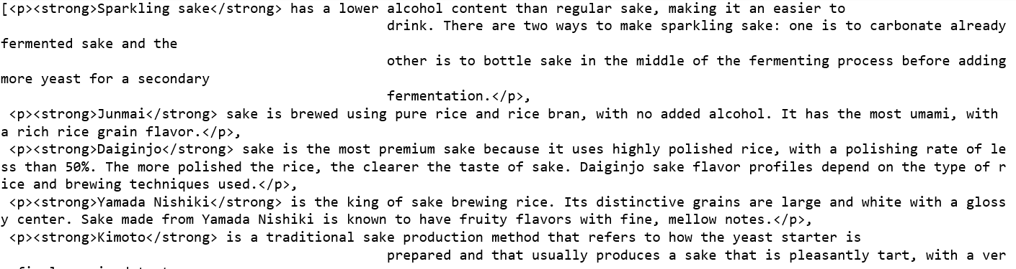
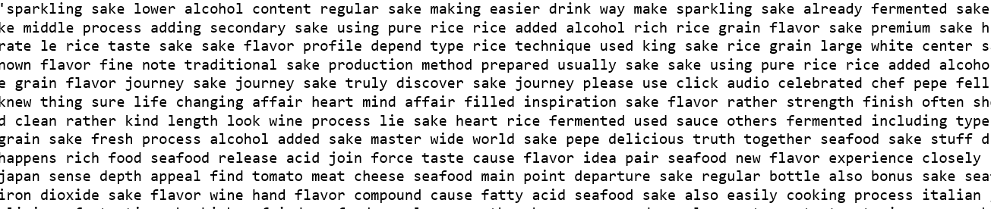

contd.
Data before cleaning:
Data after cleaning:

Slide 11
Get only valid data.
data['Articles'] = data['Articles'].apply(lambda x: BeautifulSoup(x, 'html.parser').get_text())
# Remove all punctuations.
data['Articles'] = data['Articles'].str.replace('[^\w\s]', ' ')
# Remove all numbers and inbetween numbers.
data['Articles'] = data['Articles'].str.replace('\w*\d\w*', ' ')
# Remove all new line characters
data['Articles'] = data['Articles'].str.replace('\s+', ' ')
# Lower all values.
data['Articles'] = data['Articles'].apply(lambda x: ' '.join(x.lower() for x in x.split()))
# Remove stop words.
data['Articles'] = data['Articles'].apply(lambda x: ' '.join(x for x in x.split() if x not in stopwords))
# Remove underscores if any - Added after EDA.
data['Articles'] = data['Articles'].apply(lambda x: ' '.join(x.replace('_', ' ') for x in x.split()))
# Remove junk words with lenght less than 2.
data['Articles'] = data['Articles'].apply(lambda x: ' '.join(x for x in x.split() if len(x)>2))
# Remove all words that occure less tha 5 times in full data provided for cleaning.
freq = pd.Series(' '.join(data['Articles']).split()).value_counts()
rare_words = list(freq.index[freq.values < 5])
data['Articles'] = data['Articles'].apply(lambda x: ' '.join(x for x in x.split() if x not in rare_words))
# Stemm and lemmatize the words.
st = LancasterStemmer()
data['Articles'] = data['Articles'].apply(lambda x: ' '.join(st.stem(x) for x in x.split()))
lt = WordNetLemmatizer()
data['Articles'] = data['Articles'].apply(lambda x: ' '.join(lt.lemmatize(x) for x in x.split()))

Slide 12
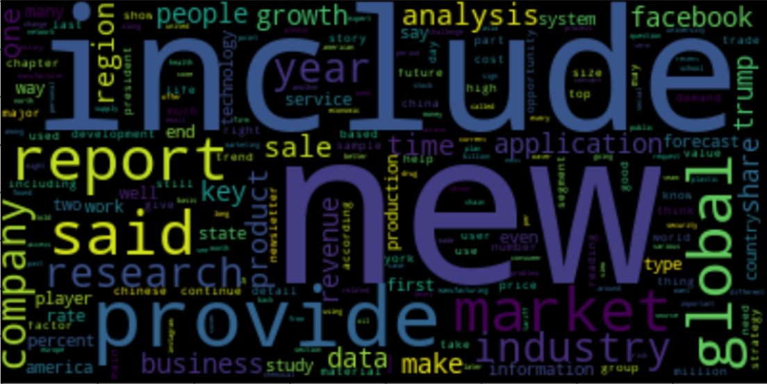
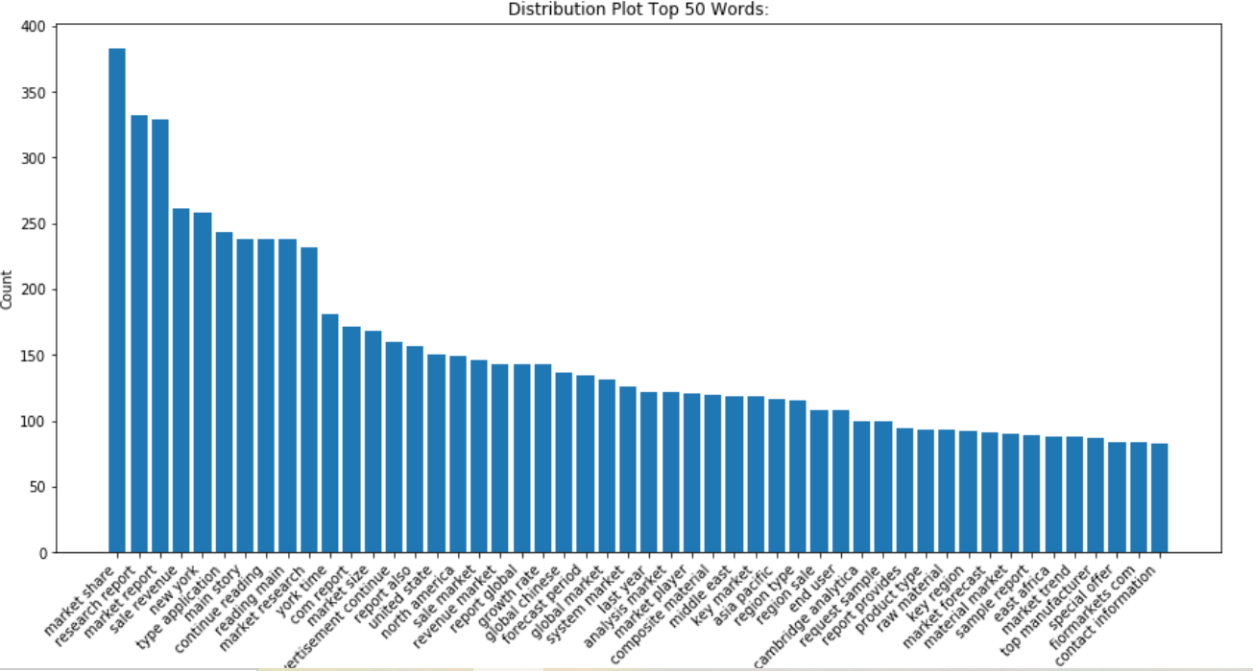
EDA: News Articles

Slide 13
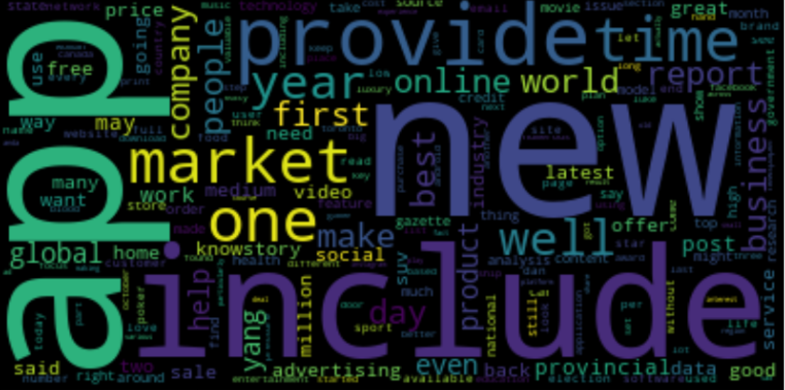
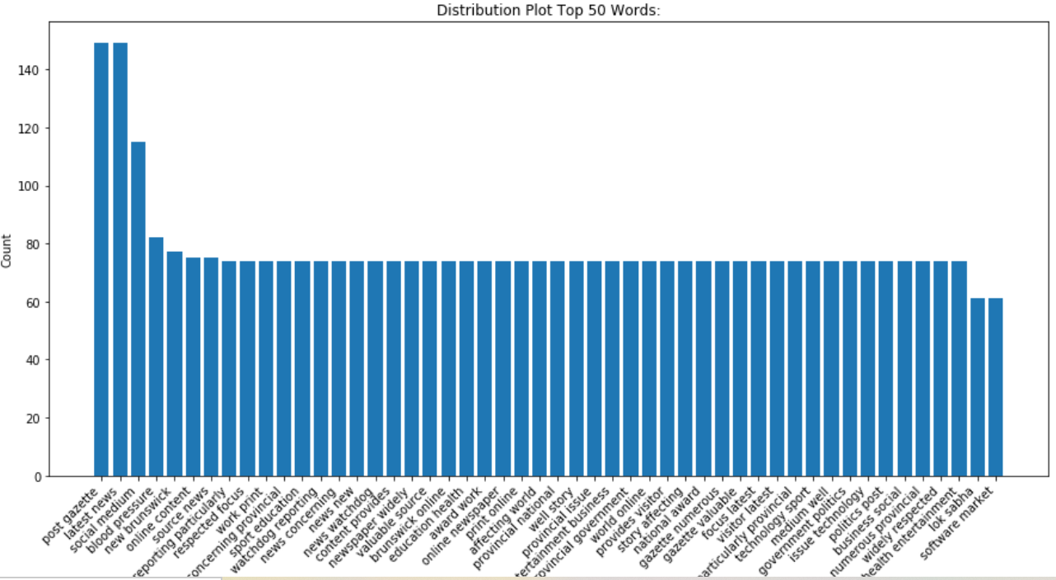
EDA: AD Articles

Slide 14
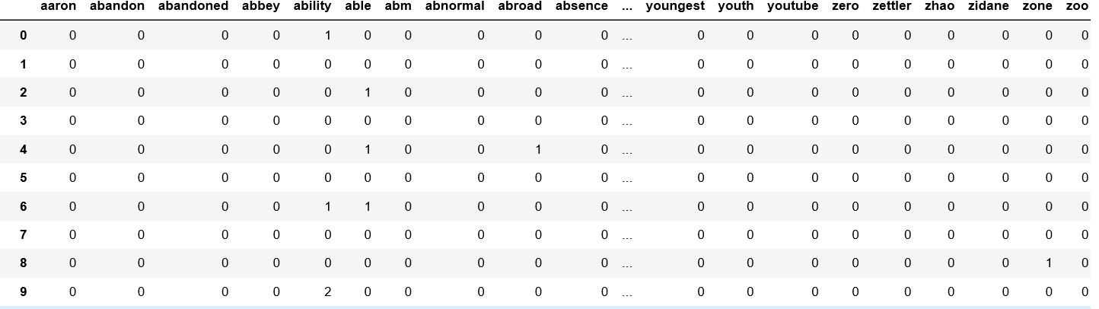
ML Modelling:
First text data is converted to document matrix so that it can be input to model.
Used Naive Bayes for classifying News and Ad Articles.
contd.

Slide 15
contd.
Then data was divided into training and test sets followed by Model Building, Model Training and Testing.
Below are few ML models used and efficiency was calculated.
Naive Bayes Classifier
Confusion Matrix: [[28 3] [ 2 19]] Accuracy: 0.903
Logistic Regression
Confusion Matrix: [[31 0] [ 5 16]] Accuracy: 0.903
SVM Model
Confusion Matrix: [[31 0] [ 9 12]] Accuracy: 0.826
Bagging Model – RFC
Confusion Matrix: [[31 0] [ 5 16]] Accuracy: 0.903
Boosting Model – XGB
Confusion Matrix: [[31 0] [ 2 19]] Accuracy: 0.961
contd.

Slide 16
contd.
Vectorizer for creating document matrix:
vectorizer = CountVectorizer(analyzer='word',token_pattern=r'\b[^\d\W]+\b’)
vectorizer.fit(X_train) # Fit
Xtrain = vectorizer.transform(X_train).toarray() # Create vectors.
Xtest = vectorizer.transform(X_test).toarray() # Create vectors.
Creating ML Model and training it:
modelNB = MultinomialNB()
spam_model = model.fit(Xtrain, y_train)
y_pred = spam_model.predict(Xtest)
Testing model and calculating accuracy:
conf_mat = confusion_matrix(y_test, y_pred)
accuracy = accuracy_score(y_test, y_pred)

Slide 17
Summary & improvements:
Data is successfully Scrapped, Cleaned and Visualized.
ML model is created which is able to classify articles as News or Advertisements.
The current experiment is like an Sand if we consider Data Science as a Beach.
Here we used around 900 articles(600 Ham, 300 spam) for training our model. The model can be made more robust using more data.
Deep Learning and Neural Networks are next step which can be used to answer such type of requirements.
Other application of NLP are like Chat Box and Topic Modelling.

Slide 18
Thanks Everyone for your Time.

